Slide 1
Feature Fusion based detection of Schizophrenia using fMRI dataset
Team No: ECE063
Panel: Inter-Disciplinary Panel
Team Members:
Mohan V | CB.EN.U4CCE20033
Nithin Rajaseharan | CB.EN.U4CCE20039
Taushiq Balamurugan | CB.EN.U4CCE20064
Varun S | CB.EN.U4CCE20069

Slide 2
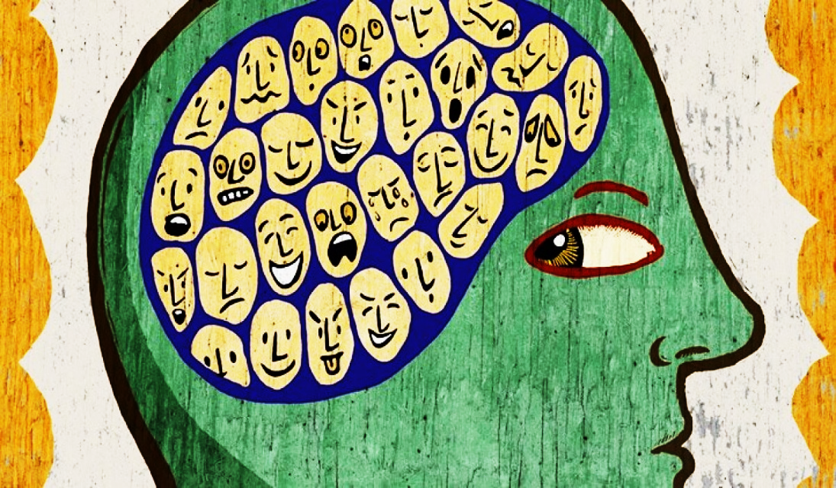
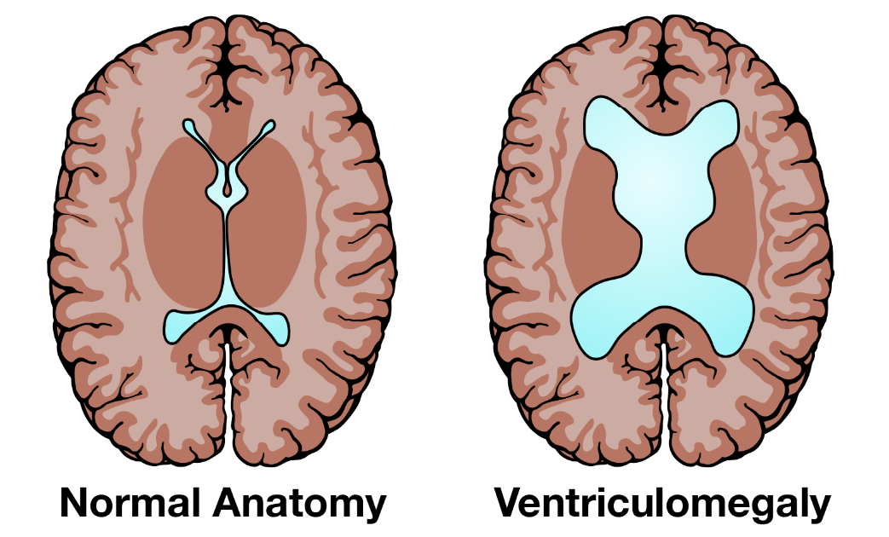
Introduction
Schizophrenia - Abnormal interpretation
of reality.
Symptoms : hallucinations, delusions, disorganized thinking, and emotional disturbances.
According to WHO, 20 million people worldwide have schizophrenia.
Brain abnormalities:
Reduced gray matter volume
Enlarged ventricles
White matter abnormalities

Slide 3
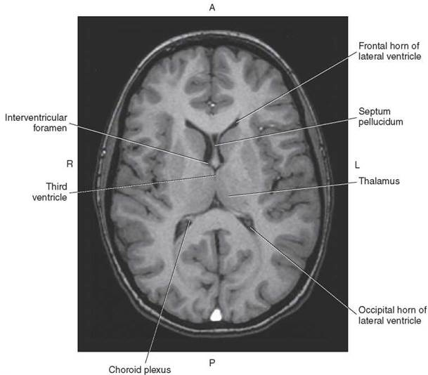
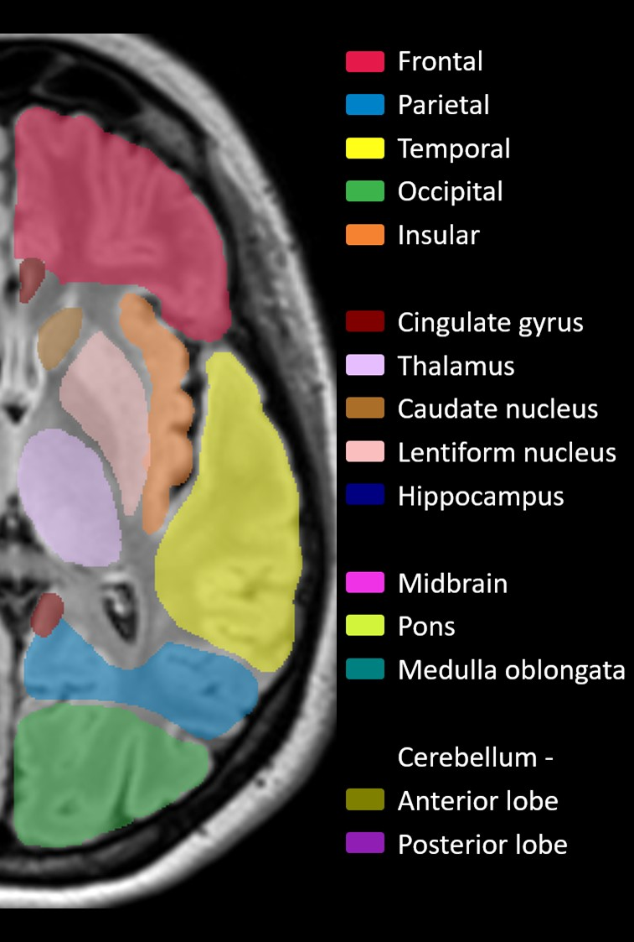
Introduction – Anatomy of brain

Slide 4
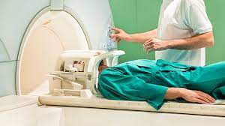
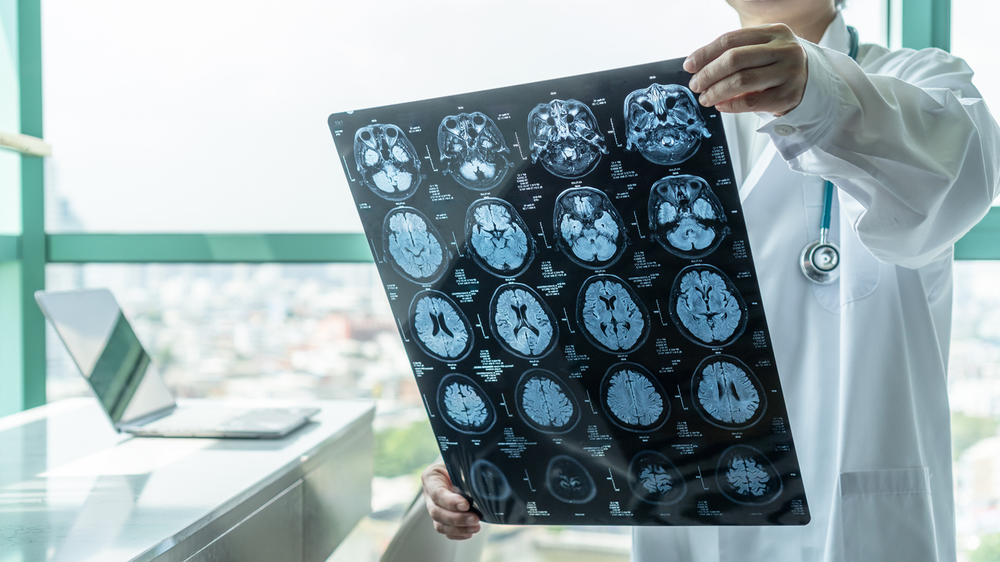
Problem statement
Subjective evaluation by psychiatrist.
Neuroradiologists interprets MRI images and provide diagnostic report.
Psychiatrist evaluates the report.
This manual examination is a time-consuming process.
Misdiagnosis due to lack of CAD system for evaluation.

Slide 5
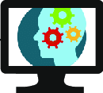
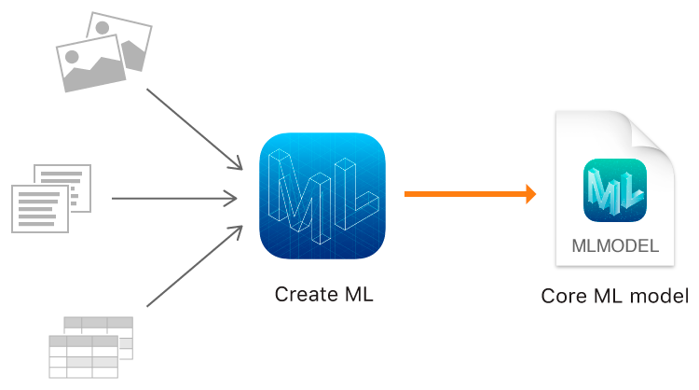

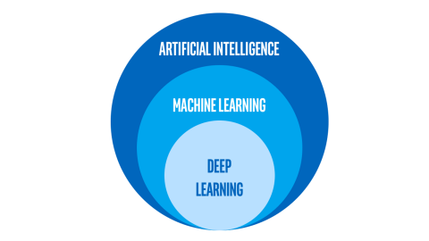
Objectives
Computer-Aided Diagnosis (CAD) system for schizophrenia
detection using fMRI dataset
Implementation of CAD system using Machine Learning features
Implementation of CAD system using Deep Learning features
Integration of ML features and DL features to create a standard
CAD system for the diagnosis of schizophrenia

Slide 6
Literature Survey
S.No | Paper Title (Citation score) | Publication | Year
1 | Framework to Detect Schizophrenia in Brain MRI Slices with Mayfly Algorithm-Selected Deep and Handcrafted Features (1.86) | Journal of Sensors, vol. 23, no. 1, pp. 280, Multidisciplinary Digital Publishing Institute(MDPI) | 2022
2 | Diagnosis of schizophrenia based on deep learning using fMRI (1.87) | Computational and Mathematical Methods in Medicine, Hindawi Limited | 2021
3 | Detecting abnormal brain regions in schizophrenia using structural MRI via machine learning (2.83) | Computational intelligence and neuroscience, Hindawi Limited | 2020
4 | Fusion of handcrafted and deep features for medical image classification (1.56) | Journal of Physics: Conference Series, vol. 1345. No. 2. Institute of Physics Publishing Publishing | 2019
5 | Machine learning techniques in a structural and functional MRI diagnostic approach in schizophrenia: a systematic review (1.45) | Neuropsychiatric Disease Treatment : 1605-1627, Dove Medical Press Ltd | 2019

Slide 7
Literature Survey
S.No. | Paper Title (Citation score) | Publication | Year | Inference
6 | Brain MRI-based 3D Convolutional Neural Networks for Classification of Schizophrenia and Controls (4.08) | International Conference of the IEEE Engineering in Medicine & Biology Society (EMBC), IEEE | 2020 | 3D CNN model GM and WM based ML model Performance of CNN model is better than ML model.
7 | Predicting Schizophrenia from fMRI Using Deep Learning (2.99) | Springer Science and Business Media | 2022 | DL model with SVC for fMRI data Accuracy: 0.88
8 | Machine learning techniques for the Schizophrenia diagnosis: a comprehensive review and future research directions (1.95) | Springer Science and Business Media | 2023 | For accurate prediction, selective feature extraction and selection of model is important Performance of DL method is better than ML method.
9 | Structural neuroimaging as clinical predictor: A review of machine learning applications (2.95) | Neuroimage: Clinical, Elsevier Inc. | 2018 | For diagnosis, fMRI are used. All ML methods showed 61.8–95% accuracy
10 | Towards artificial intelligence in mental health: a comprehensive survey on the detection of schizophrenia (3.83) | Multimedia Tools and Applications, John Wiley and Sons Ltd | 2023 | CAD systems assist radiologists and doctors in the early diagnosis Deep learning is the most effective method.

Slide 8
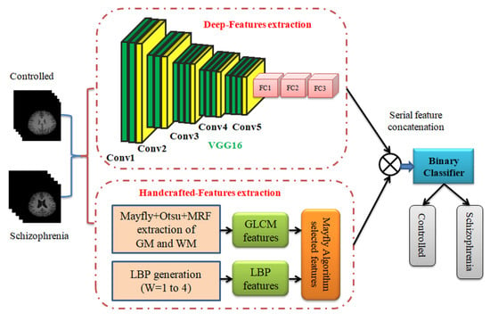
Literature Survey – BASE PAper
Title: Framework to Detect Schizophrenia in Brain MRI Slices with Mayfly Algorithm-
Selected Deep and Handcrafted Features
Publication: Journal of Sensors, Multidisciplinary Digital Publishing Institute (2022)
Inference:
fMRI dataset - 20 schizophrenia and
20 controlled images
Accuracy:
DF – 90%
HF – 85%
DF + HF – 94%
DF+HF is better compared with other methods

Slide 9
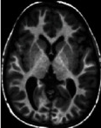
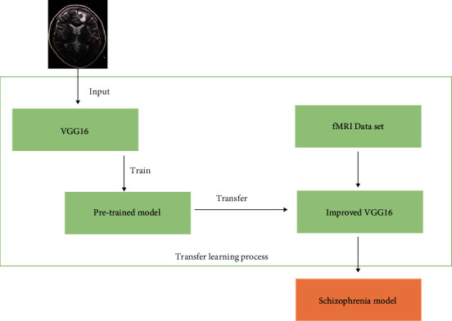
Literature Survey – Reference PAper
Title: Diagnosis of schizophrenia based on deep learning using fMRI
Publication: Computational and Mathematical Methods in Medicine, Hindawi Limited (2021)
Inference:
Preprocessed fMRI data
Transfer learning for VGG16
Accuracy – 87.85%
Improved the diagnosis of schizophrenia
Solves the classification problem of small dataset

Slide 10
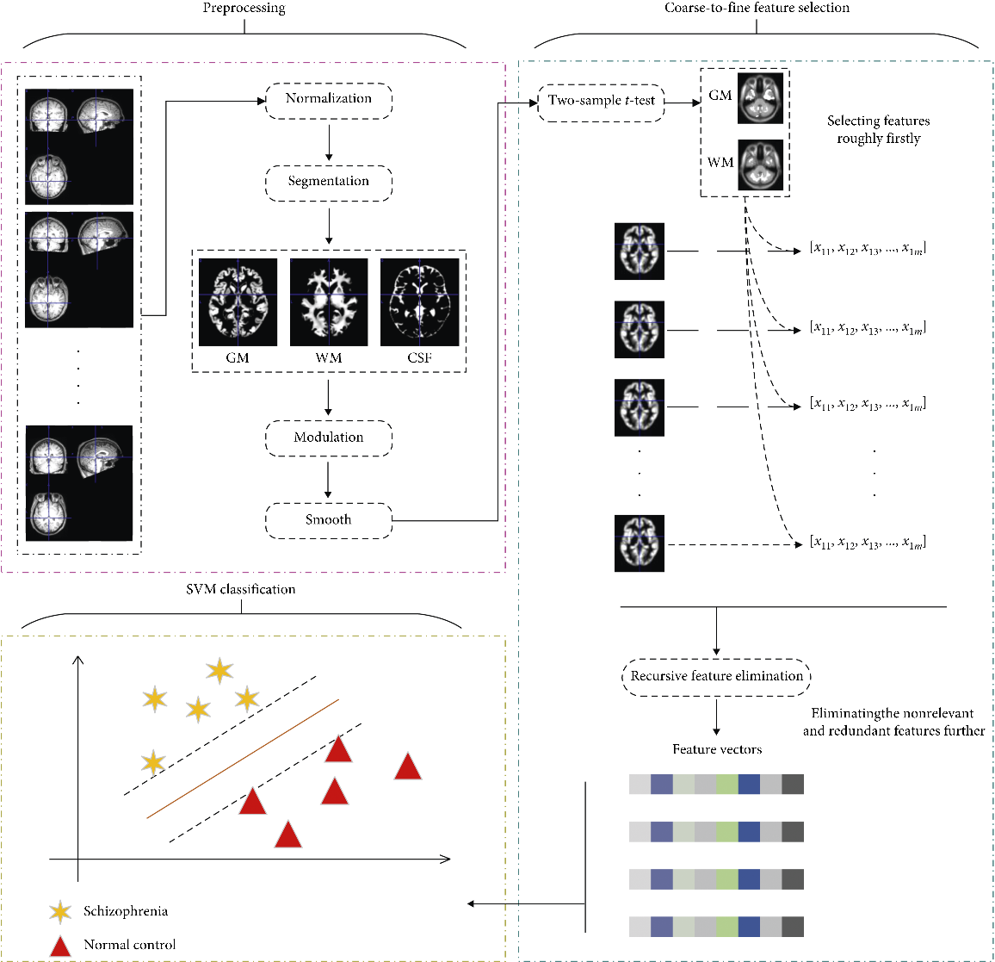
Literature Survey – Reference PAPER
Title: Detecting abnormal brain regions in schizophrenia using structural
MRI via machine learning
Publication: Computational intelligence and neuroscience, Hindawi Limited, 2020
Inference:
Feature - Gray matter(GM) and White matter(WM)
Two-sample t-tests to extract features
Further elimination of redundant features with by RFE
Accuracy - 85%
Classification performance of WM was significantly better than that of GM

Slide 11
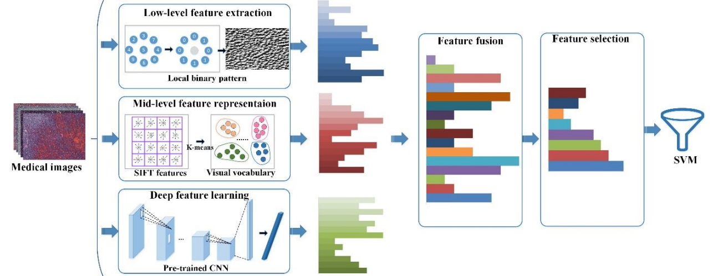
Literature Survey – Reference PAper
Title: Fusion of handcrafted and deep features for medical image classification Publication: Journal of Physics: Conference Series, vol. 1345. No. 2. Institute of Physics Publishing Publishing (2019)
Inference:
Medical image classification
Low-level feature extraction – extract global texture features and semantic information
Mid-level feature extraction – extract local texture features and semantic information to some extent
Deep feature extraction - Directly extract deep feature from image
To utilize the respective features, a feature fusion can be used

Slide 12
Literature Survey – Reference PAper
Title: Machine learning techniques in a structural and functional MRI diagnostic
approach in schizophrenia: a systematic review
Publication: Neuropsychiatric Disease Treatment : 1605-1627, Dove Medical Press Ltd (2019)
Inference:
Diverse inputs (GM & WM) improve the accuracy
Accuracy – 75% to 90% in classification
Integration of multiple ML feature extraction techniques will be increasingly helpful in the extraction of features

Slide 13
Literature Survey - summary
Key Takeaways:
fMRI data is mostly used.
Diverse feature inputs improve the accuracy
Integration of multiple ML feature extraction techniques will be increasingly helpful in the extraction of features
Elimination of redundant features with RFE
Data augmentation in DL will help model feature extraction and generalization.
Transfer learning for pre-trained model will have higher accuracy than creating a model.
To utilize the respective features, a feature fusion can be used.

Slide 14
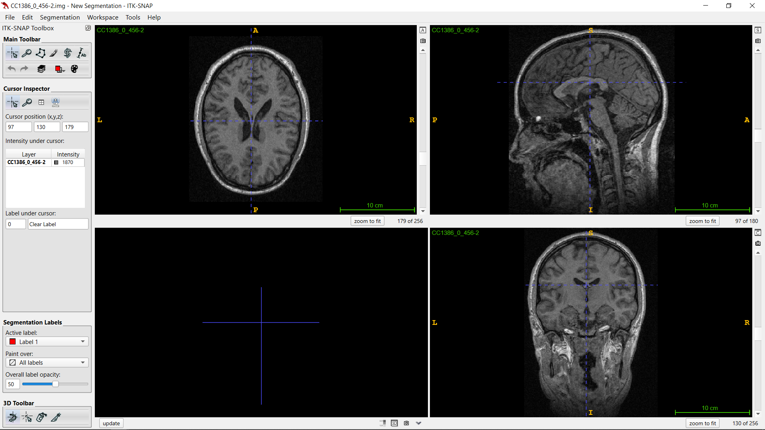
Data Preprocessing
Software: ITK-Snap
Axial
Sagittal
Coronal

Slide 15
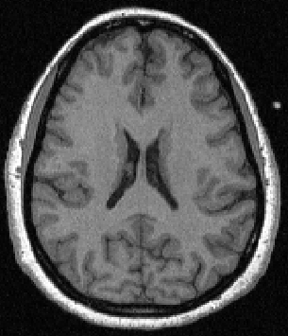
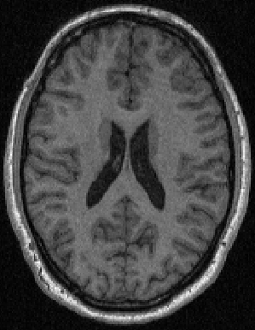
Data Preprocessing
Source: NUSDAST
Healthy : 125
Schizophrenia: 125
Healthy fMRI Axial plane
Schizophrenia fMRI Axial plane

Slide 16
Methodology
GLCM
Axial plane
Slice
fMRI Dataset
LBP
RFE
Binary Classifier
HOG
Healthy
Schizophrenia
Machine Learning Model Implementation

Slide 17
Methodology
Pre-Trained CNN model
Axial plane
Slice
fMRI Dataset
Result
Healthy
Schizophrenia
Deep Learning Model Implementation

Slide 18
Methodology
Deep Learning Feature Extraction
VGG19 (Transfer Learning)
RFE
[Recursive Feature Elimination]
Binary Classifier
Axial plane
Slice
Feature Concatenation
fMRI Dataset
Machine Learning Feature Extraction
[GLCM + LBP + HOG]
Healthy
Schizophrenia
ML + DL Model Implementation

Slide 19
ML Result
Table: Comparison of various models with one feature
Single Feature | Logistic Regression |  |  | Random Forest |  |  | SVM |  |  | XGBoost |  |  | Adaboost |  |  | Histogram-based Gradient Boosting
Metrics | Acc | Sens | Spe | Acc | Sens | Spe | Acc | Sens | Spe | Acc | Sens | Spe | Acc | Sens | Spe | Acc | Sens | Spe
GLCM | 0.70 | 0.70 | 0.70 | 0.62 | 0.52 | 0.62 | 0.64 | 0.65 | 0.63 | 0.58 | 0.57 | 0.56 | 0.58 | 0.61 | 0.56 | 0.58 | 0.61 | 0.56
LBP
 | 0.64 | 0.65 | 0.63 | 0.76 | 0.74 | 0.78 | 0.72 | 0.74 | 0.70 | 0.78 | 0.78 | 0.78 | 0.62 | 0.57 | 0.67 | 0.72 | 0.74 | 0.70
HOG
 | 0.84 | 0.78 | 0.89 | 0.82 | 0.78 | 0.85 | 0.78 | 0.83 | 0.74 | 0.80 | 0.78 | 0.80 | 0.76 | 0.83 | 0.70 | 0.86 | 0.83 | 0.89
Table: Comparison of various models with two features combined
Double Feature | Logistic Regression |  |  | Random Forest |  |  | SVM |  |  | XGBoost |  |  | Adaboost |  |  | Histogram-based Gradient Boosting
Metrics | Acc | Sens | Spe | Acc | Sens | Spe | Acc | Sens | Spe | Acc | Sens | Spe | Acc | Sens | Spe | Acc | Sens | Spe
GLCM+ LBP | 0.66 | 0.65 | 0.67 | 0.70 | 0.65 | 0.74 | 0.72 | 0.70 | 0.74 | 0.72 | 0.65 | 0.78 | 0.62 | 0.61 | 0.63 | 0.70 | 0.65 | 0.78
GLCM+ HOG
 | 0.84 | 0.83 | 0.86 | 0.82 | 0.78 | 0.84 | 0.85 | 0.87 | 0.88 | 0.76 | 0.70 | 0.76 | 0.84 | 0.87 | 0.84 | 0.84 | 0.78 | 0.89
LBP+ HOG
 | 0.78 | 0.78 | 0.81 | 0.78 | 0.74 | 0.81 | 0.76 | 0.83 | 0.78 | 0.82 | 0.70 | 0.85 | 0.74 | 0.78 | 0.70 | 0.84 | 0.78 | 0.86
Acc- Accuracy; Sens –Sensitivity; Spe - Specificity

Slide 20
ML Result
Table: Comparison of various models from PCA and RFE with all features combined [70-30 split]
All Feature | Logistic Regression |  |  | Random Forest |  |  | SVM |  |  | XGBoost |  |  | Adaboost |  |  | Histogram-based Gradient Boosting
Metrics | Acc | Sens | Spe | Acc | Sens | Spe | Acc | Sens | Spe | Acc | Sens | Spe | Acc | Sens | Spe | Acc | Sens | Spe
GLCM +LBP +HOG | 0.65 | 0.64 | 0.65 | 0.76 | 0.62 | 0.81 | 0.80 | 0.82 | 0.78 | 0.76 | 0.70 | 0.76 | 0.77 | 0.69 | 0.86 | 0.87 | 0.85 | 0.89
GLCM +LBP +HOG [PCA] | 0.84 | 0.89 | 0.79 | 0.76 | 0.84 | 0.68 | 0.85 | 0.89 | 0.82 | 0.73 | 0.62 | 0.84 | 0.60 | 0.62 | 0.76 | 0.73 | 0.70 | 0.76
GLCM +LBP +HOG [RFE] | 0.87 | 0.89 | 0.84 | 0.88 | 0.92 | 0.84 | 0.87 | 0.82 | 0.82 | 0.79 | 0.73 | 0.84 | 0.84 | 0.81 | 0.87 | 0.89 | 0.89 | 0.89
Acc- Accuracy; Sens –Sensitivity; Spe - Specificity

Slide 21
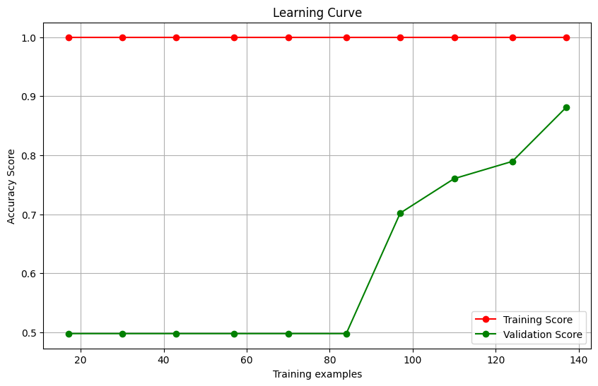
ML Result
Accuracy | 0.89
Precision | 0.89
Sensitivity (Recall): | 0.89
Specificity | 0.89
F1 score | 0.89
AUC-ROC Score | 0.96
Confusion matrix | [[34 4] [ 4 34]]
Features | GLCM + LBP + HOG
Feature Elimination | RFE (Estimator – Logistic Regression)
Train-test split | 70-30 [250 images]
Classifier | Histogram-based Gradient Boosting Classifier
Table: ML method
Cross Validation on Training dataset
Validation Accuracy – 0.88
Table: ML Performance Metrics
Platform | Jupyter Notebook (Google Colab)
System RAM | 13 GB
Disk | 107 GB
Overall Training time | 20 mins 40 secs
Table: Device Specifications

Slide 22
DL Result
Table: Comparison of CNN models’ performance metrics [70-30 split]
Model | Performance metrics
 | Accuracy | Sensitivity | Specificity | Precision | F1 score | AUC-ROC Score
VGG16 | 86.6% | 86.8% | 86.4% | 87% | 0.868 | 0.92
VGG19 | 90.6% | 88.5% | 92.5% | 91% | 0.898 | 0.954
ResNet152V2 | 86.6% | 81.5% | 91.8% | 91% | 0.861 | 0.911
InceptionV3 | 89.3% | 89% | 92% | 91% | 0.904 | 0.95
MobileNet | 87.9% | 83.7% | 92% | 91% | 0.873 | 0.96
DenseNet121 | 85.3% | 89% | 81% | 82% | 0.857 | 0.932

Slide 23
DL Result
CNN Model | VGG19
Epochs | 50 [3s/4s per epoch]
Loss | Binary Cross entropy
Learning rate | 0.001
Classifier | SoftMax
Train-test split | 70-30 [250 images]
Augmented images | 1,17,200
Test Accuracy | 90.6%
Precision | 91.1%
Sensitivity (Recall): | 88.5%
Specificity | 92.5%
F1 score | 0.898
ROC AUC Score | 0.95
Confusion matrix | [[37 3] [4 31]]
Table: DL method
Platform | Jupyter Notebook (Google Colab)
System RAM | 13 GB
GPU RAM | 15 GB
Disk | 78 GB
Overall Training time | 3 mins 30 secs
Table: DL Performance Metrics
Table: Device Specifications

Slide 24
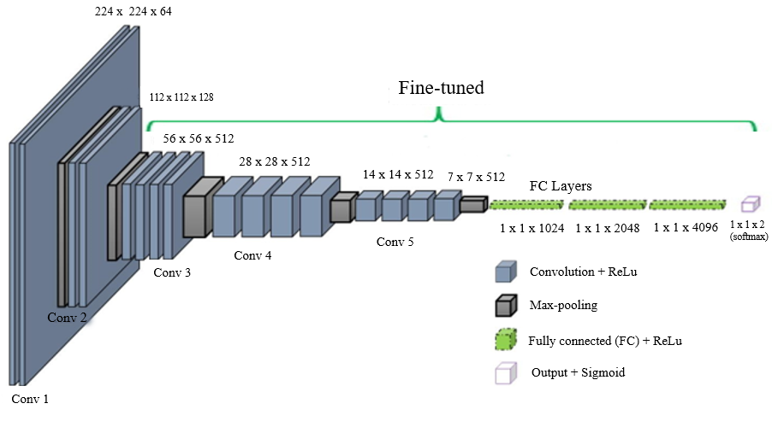
VGG-19 architecture
Pre-Trained VGG19 model
Axial plane
Slice
MRI Dataset
Result
Healthy
Schizophrenia

Slide 25
VGG-19 architecture
Original VGG-19 Model
9
Output layer
(Softmax)
Input Layer
Convolutional
Block 1
Convolutional
Block 2
Convolutional
Block 3
Convolutional
Block 4
Convolutional
Block 5
Dense 1
Dense 2
Weights un-frozen layers for fine tuning
Output layer
(Softmax)
Input
Base Model
Dense 1
Dense 2
Dense 3
Fine Tuning Model
DL Architecture
Layers | Output Shape | Parameter
VGG19 | (7,7,512) | 20024384
Flatten | (25088) | 0
dense_1 (Dropout=0.5) | (1024) | 25691136
dense_2 (Dropout=0.5) | (2048) | 2099200
dense_3 | (4096) | 8392704
dense_4 (SoftMax) | (2) | 8194
Table: Model Layers and parameter

Slide 26
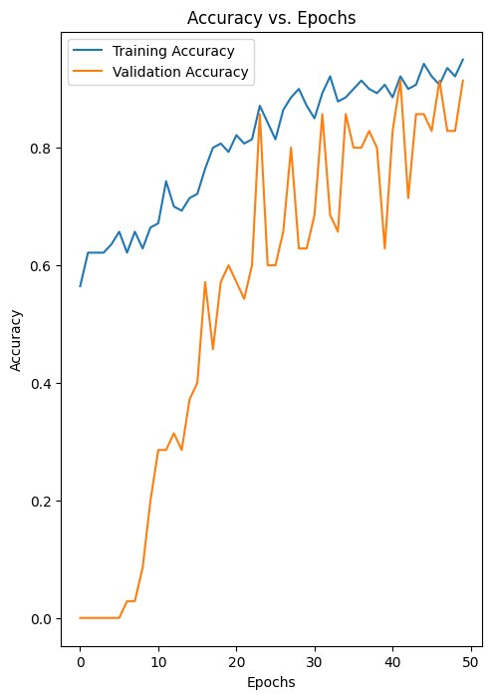
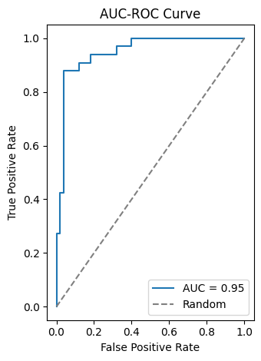
DL Result
Training vs Validation Accuracy graph AUC-ROC Score: 0.95

Slide 27
ML+DL Result
Table: Comparison of various models from RFE with ML and DL features combined [70-30 split]
ML + DL Feature | ML (GLCM+LBP+HOG) + DL (VGG-19) -> [RFE]
Classifier | Logistic Regression | Random Forest | SVM | XGBoost | Adaboost | HistGrading Boosting
Accuracy | 0.89 | 0.94 | 0.80 | 0.90 | 0.91 | 0.93
Sensitivity | 0.89 | 0.94 | 0.83 | 0.86 | 0.89 | 0.91
Specificity | 0.89 | 0.94 | 0.77 | 0.94 | 0.94 | 0.94

Slide 28
ML+DL Architecture
1024 features
Deep Feature Extraction
VGG19 (Transfer Learning)
1536 features
1024
features
Axial plane
Slice
Feature Concatenation
Binary Classifier
fMRI Dataset
RFE
Machine Learning Feature Extraction
[GLCM + LBP + HOG] -> RFE
512
features
Healthy
Schizophrenia
MF + DF Implementation

Slide 29
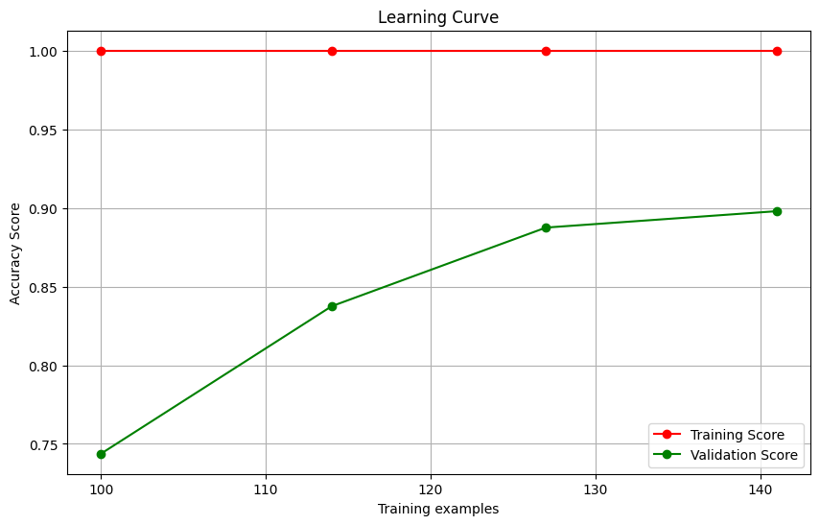
ML+DL Result
Table: ML Performance Metrics
Features | ML (GLCM + LBP + HOG) + DL (VGG19)
Feature Elimination | RFE (Estimator – Logistic Regression)
Train-test split | 70-30 [250 images]
Classifier | Random Forest Classifier
Accuracy | 0.94
Precision | 0.94
Sensitivity (Recall): | 0.94
Specificity | 0.94
F1 score | 0.94
ROC AUC Score | 0.98
Confusion matrix | [[33 2] [ 2 33]]
Table: ML+DL method
Fig. : Cross Validation on Training dataset
Validation Accuracy – 0.90
Table: Device Specifications
Platform | Jupyter Notebook (Google Colab)
System RAM | 13 GB
GPU RAM | 15 GB
Disk | 78 GB
Overall Training time | 28 mins

Slide 30
Cad system Flow diagram – VGg19
Website backend
1024 features
dense_1 layer
Deep Feature Extraction
[VGG19.h5]
1536
features
1024
features
fMRI file
(.img/.nii)
Axial plane
(.png)
Feature Concatenation
Binary Classifier
RFE
Machine Learning Feature Extraction
[GLCM + LBP + HOG] -> RFE
Healthy
Schizophrenia
512
features
Diagnostic Result

Slide 31

Cad system DEMO - NUSDAST

Slide 32
Cad system DEMO - OPENneuro

Slide 33

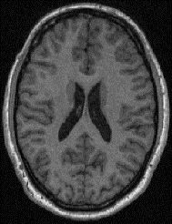


ViT Architecture
Transformer Encoder
MLP Classifier
MLP
Transformer Encoder
Axial plane
Slice
Norm
MRI Dataset
Result
Patch + Position embedding
*
……….
0
1
2
3
]
Healthy
Multi-Head
Self Attention
Linear Projection of Flattened patches
……….
Schizophrenia
Norm
Embedded patches
Pre-Trained ViT Implementation

Slide 34
ViT Result
Test Accuracy | 0.957
Precision | 0.94
Sensitivity (Recall): | 0.97
Specificity | 0.94
F1 score | 0.957
ROC AUC Score | 0.957
Confusion matrix | [[33 2] [1 34]]
Epochs | 5 [10s per epoch]
Loss | Binary Cross entropy
Learning rate | 0.00002
Classifier | Multi-layer perceptron
Train-test split | 70-30 [150(train)-30(val)-70(test) images]
Table: ViT method
Platform | Jupyter Notebook (Google Colab)
System RAM | 13 GB
GPU RAM | 15 GB
Disk | 78 GB
Overall Training time | 1 min
Table: ViT Performance Metrics
Table: Device Specifications

Slide 35
ML+Vit Architecture
Deep Feature Extraction
Vision Transformer [.pth]
Axial plane
Slice
Feature Concatenation
Binary Classifier
fMRI Dataset
RFE
Machine Learning Feature Extraction
[GLCM + LBP + HOG] -> RFE
Healthy
Schizophrenia
MF + ViT Implementation

Slide 36
ML+Vit Result
Table: Comparison of various models from RFE with ML and ViT features combined [70-30 split]
ML + ViT Feature | ML (GLCM+LBP+HOG) + ViT -> [RFE]
Classifier | Logistic Regression | Random Forest | SVM | XGBoost | Adaboost | HistGrading Boosting
Accuracy | 0.79 | 0.89 | 0.79 | 0.93 | 0.95 | 0.93
Sensitivity | 0.93 | 0.90 | 0.93 | 0.93 | 0.95 | 0.93
Specificity | 0.65 | 0.88 | 0.65 | 0.93 | 0.95 | 0.93

Slide 37
Ml+ViT Result
Test Accuracy | 0.95
Precision | 0.95
Sensitivity (Recall): | 0.95
Specificity | 0.95
F1 score | 0.95
ROC AUC Score | 0.98
Confusion matrix | [[38 2] [2 38]]
Features | ML (GLCM + LBP + HOG) + ViT
Feature Elimination | RFE (Estimator – Logistic Regression)
Train-test split | 70-30 [250 images]
Classifier | Adaboost Classifier
Table: ML + ViT method
Platform | Jupyter Notebook (Google Colab)
System RAM | 13 GB
GPU RAM | 15 GB
Disk | 78 GB
Overall Training time | 31min
Table: ViT Performance Metrics
Table: Device Specifications

Slide 38
Cad system Flow diagram -Vit
Website backend
3072 features – 12th layer
Deep Feature Extraction
[ViT.pth]
3584
features
1536
features
Binary Classifier
fMRI
Axial plane
Feature Concatenation
RFE
Machine Learning Feature Extraction
[GLCM + LBP + HOG] -> RFE
Healthy
Schizophrenia
512
features
Diagnostic Result

Slide 39
Cad system DEMO using Vit – Openneuro

Slide 40
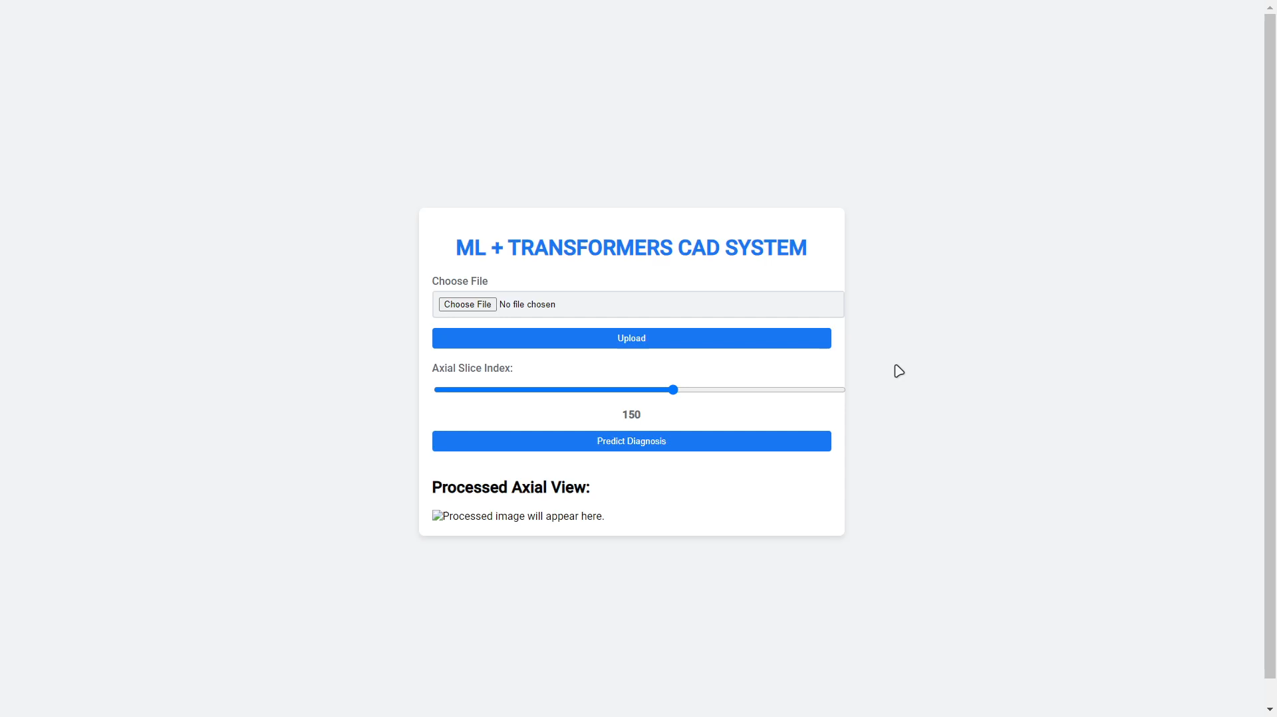
Cad system DEMO using Vit – Openneuro

Slide 41
Openneuro dataset result
File Name | Diagnosis | Axial Slice Index
sub-01_T1w.nii | Healthy | 148,149,150,151
sub-05_T1w.nii | Healthy | 148,149,150,151,152
sub-09_T1w.nii | Healthy | 142,143,144,145,146
sub-15_T1w.nii | Healthy | 146,147,148,149,150,151
sub-20_T1w.nii | Healthy | 147,148,149,150,151,152,153
sub-36_T1w.nii | Healthy | 143,144,145,146,147,148,149
sub-38_T1w.nii | Healthy | 143,144,145,146,147

Slide 42
Openneuro dataset result
File Name | Diagnosis | Axial Slice Index
sub-07_T1w.nii | Schizophrenia | 143,144,145,146,147
sub-11_T1w.nii | Schizophrenia | 147,148,149,150,151
sub-12_T1w.nii | Schizophrenia | 144,145,146,147,148
sub-17_T1w.nii | Schizophrenia | 144,145,146,147,148,148,149,150
sub-27_T1w.nii | Schizophrenia | 129,130,131,132
sub-35_T1w.nii | Schizophrenia | 148,149,150,151
sub-37_T1w.nii | Schizophrenia | 144,145,146,147,148,149

Slide 43
Cad system specification
Table: Local Device Specifications
Platform | Windows 11
Browser | Google Chrome
Tech Stack | Flask, HTML, CSS, Python
System RAM | 8 GB
Prediction Time | 3 to 5 secs

Slide 44
Comparision with previous works
Dataset | Modality | Methods | Performance | References
OpenNeuro / SCZ-20, HC – 20 | fMRI | VGG16, VGG19, InceptionV3 | Acc-91% | [1]
COBRE / SCZ-102, HC-98 | fMRI | VGG16 | Acc-84% | [2]
OpenNeuro / 99 | fMRI | VGG19 | Acc-91% | [11]
COBRE / SCZ-102, HC-98 | fMRI | ML and VGG16 | Acc-94.3% | [1]
NUSDAST/ SCZ-125, HC-125 | fMRI | ML and ViT | Acc - 95% | Proposed Work

Slide 45
REferences
Manic, K. S., Rajinikanth, V., Al-Bimani, A. S., Taniar, D., & Kadry, S. (2022), “Framework to Detect Schizophrenia in Brain MRI Slices with Mayfly Algorithm-Selected Deep and Handcrafted Features”, Journal of Sensors, vol. 23, no. 1, pp. 280, Multidisciplinary Digital Publishing Institute(MDPI), 2022.doi: https://doi.org/10.3390/s23010280
Zheng, JinChi, et al. , "Diagnosis of schizophrenia based on deep learning using fMRI“, Computational and Mathematical Methods in Medicine, Hindawi Limited, 2021. doi: https://doi.org/10.1155/2021/8437260
Chen, ZhiHong, et al. "Detecting abnormal brain regions in schizophrenia using structural MRI via machine learning." Computational intelligence and neuroscience, Hindawi Limited, 2020. doi: https://doi.org/10.1155/2020/6405930
Liu, Dong, et al. "Fusion of handcrafted and deep features for medical image classification." Journal of Physics: Conference Series, vol. 1345. No. 2. Institute of Physics Publishing Publishing, 2019. doi: https://doi.org/10.1088/1742-6596/1345/2/022052
de Filippis R, Carbone EA, Gaetano R, Bruni A, Pugliese V, Segura-Garcia C, De Fazio P, “Machine learning techniques in a structural and functional MRI diagnostic approach in schizophrenia: a systematic review”, Neuropsychiatric Disease Treatment : 1605-1627, Dove Medical Press Ltd, 2019. doi: https://doi.org/10.2147/NDT.S202418

Slide 46
REferences
M. Hu, K. Sim, J. H. Zhou, X. Jiang and C. Guan, "Brain MRI-based 3D Convolutional Neural Networks for Classification of Schizophrenia and Controls," 2020 42nd Annual International Conference of the IEEE Engineering in Medicine & Biology Society (EMBC), pp. 1742-1745, 2020. doi: https://10.1109/EMBC44109.2020.9176610
Kardani, Shail, Raghav Sharma, and Abhishek Sharma, "Predicting Schizophrenia from fMRI Using Deep Learning." In International Conference on Innovations in Computational Intelligence and Computer Vision, pp. 177-187, Springer Nature, 2022. doi: http://dx.doi.org/10.1007/978-981-99-2602-2_15
Verma, S., Goel, T., Tanveer, M., Ding, W., Sharma, R., & Murugan, R. , "Machine learning techniques for the Schizophrenia diagnosis: A comprehensive review and future research directions" , Journal of Ambient Intelligence and Humanized Computing, vol.14(5), pp. 4795-4807, Springer Science, 2023. doi: https://doi.org/10.1007/s12652-023-04536-6
Mateos-Pérez, José María, Mahsa Dadar, María Lacalle-Aurioles, Yasser Iturria-Medina, Yashar Zeighami, and Alan C. Evans, "Structural neuroimaging as clinical predictor: A review of machine learning applications.“, NeuroImage: Clinical vol. 20 pp. 506-522, Elsevier Inc. ,2018. doi: https://doi.org/10.1016/j.nicl.2018.08.019
Tyagi, Ashima, Vibhav Prakash Singh, and Manoj Madhava Gore. "Towards artificial intelligence in mental health: a comprehensive survey on the detection of schizophrenia." Multimedia Tools and Applications 82, no. 13 , pp. 20343-20405., Springer, 2023. doi: https://doi.org/10.1002/brb3.3002

Slide 47
REferences
S. Kadry, D. Taniar, R. Damasevicius, and V. Rajinikanth, “Automated Detection of Schizophrenia from Brain MRI Slices using Optimized Deep-Features,” Proceedings of 2021 IEEE 7th International Conference on Bio Signals, Images and Instrumentation, ICBSII 2021, Mar. 2021, doi: https://10.1109/ICBSII51839.2021.9445133

Slide 48
Thank You
Team ECE063

Slide 49
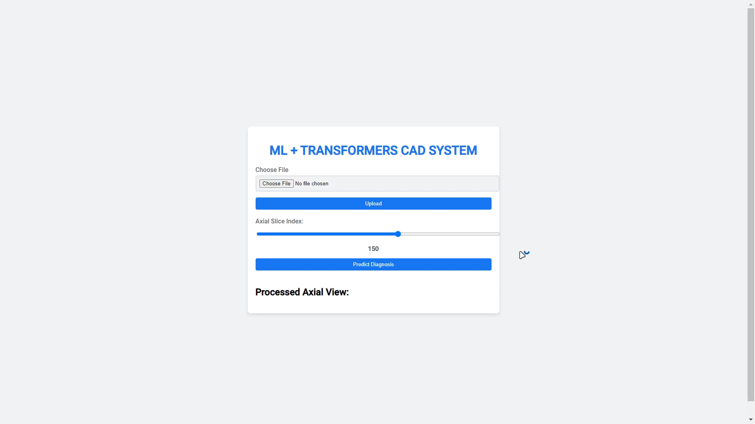
Cad system DEMO using Vit - Openneuro

Slide 50

Cad system DEMO using Vit - Openneuro

